Slide 1

Introduction to Python - Part 5
Container Objects - Tuple and Dictionary

Slide 2
Tuple

Slide 3
Tuples
Container object
Heterogeneous sequence of elements
Can have duplicates
Are immutable
Elements are separated by comma, enclosed in ( ) parenthesis

Slide 4
Tuples
Tuple supports the following operations:
in, not in
Concatenation
min(), max(), len()
Indexing and Slicing

Slide 5
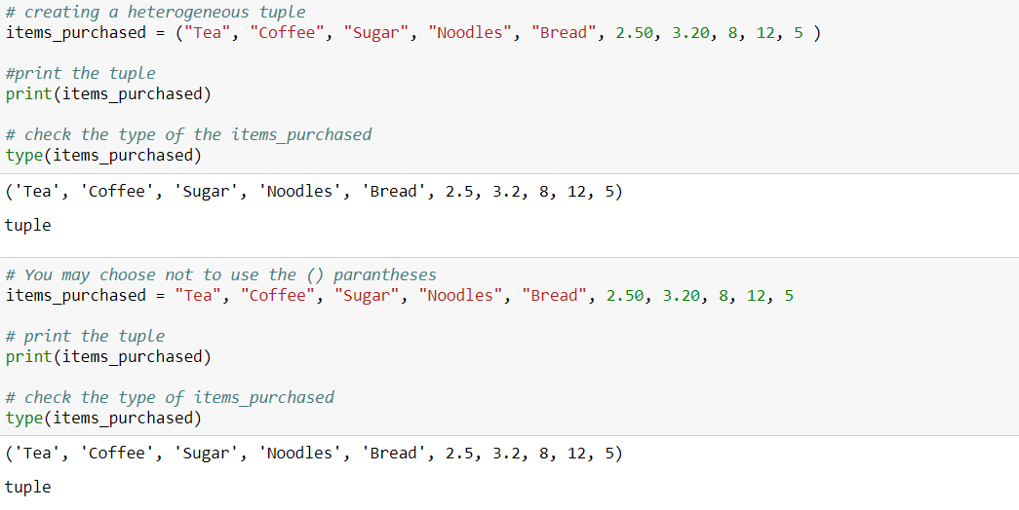
Create tuple

Slide 6
Create tuple
Although we mostly use () parentheses to create a tuple, it is not mandatory to use it

Slide 7
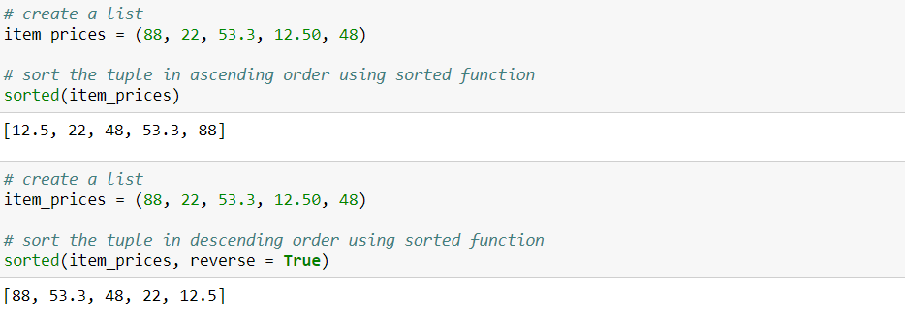
Tuple operations
Sorting the tuple elements using the sorted() function

Slide 8
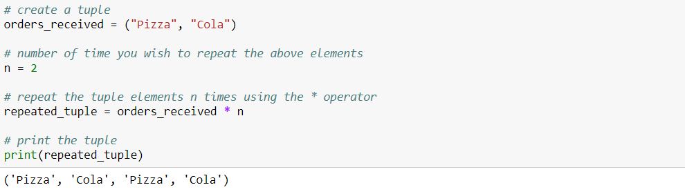
Tuple operations
Repeating the tuple elements

Slide 9
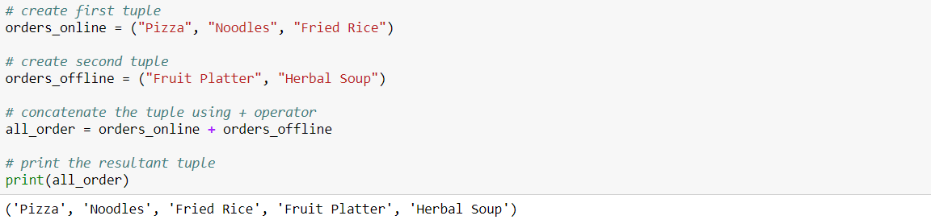
Tuple operations
Concatenating two tuple

Slide 10
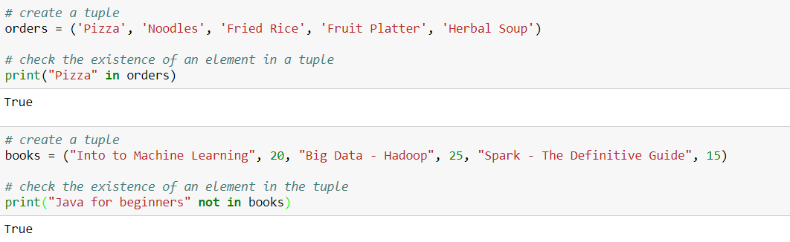
Tuple operations
Checking existence of an element using membership operators

Slide 11
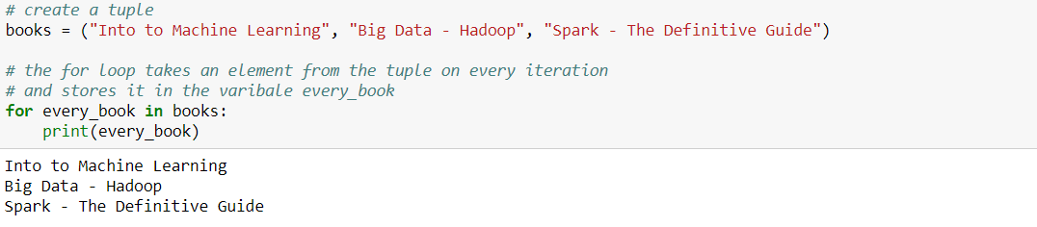
Tuple operations
Iterating through the element of a tuple

Slide 12
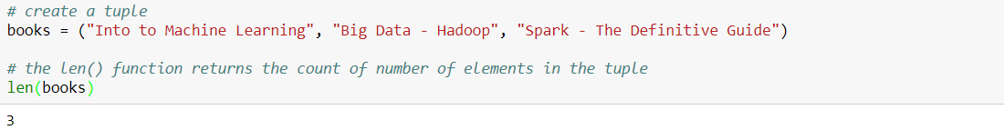
Tuple operations
Counting the number of elements in the tuple

Slide 13
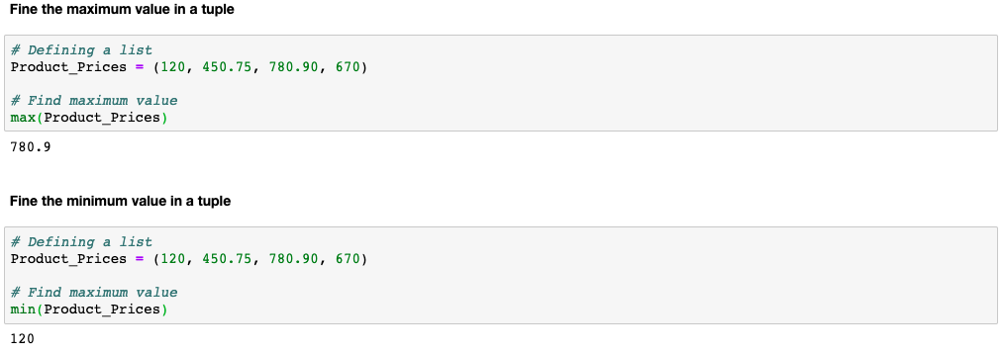
Tuple operations
Get the maximum value from the tuple
Get the minimum value from the tuple

Slide 14

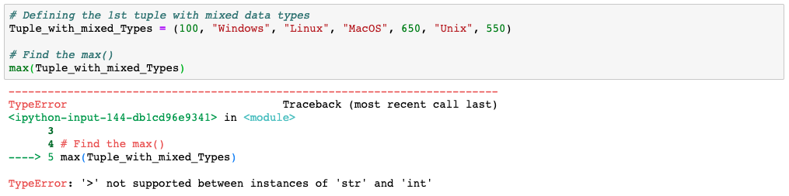
The max() & min() cannot be used on a tuple with mixed data types

Slide 15
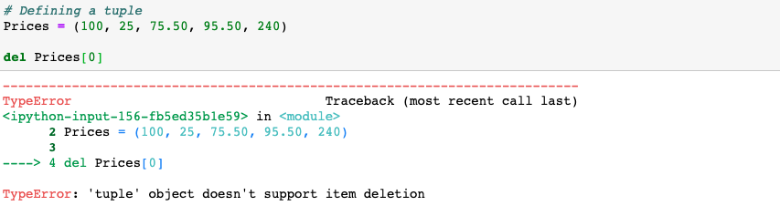
Since a tuple is immutable, a new element cannot be appended into it

Slide 16
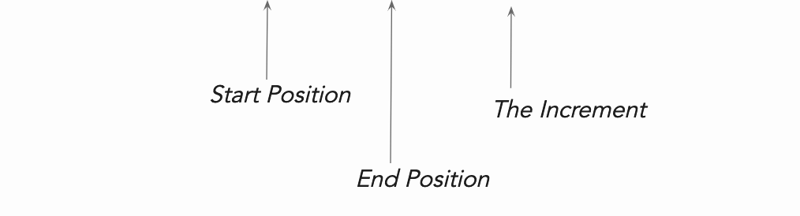
Indexing and Slicing tuples
tuple [Start, Stop, Step]

Slide 17
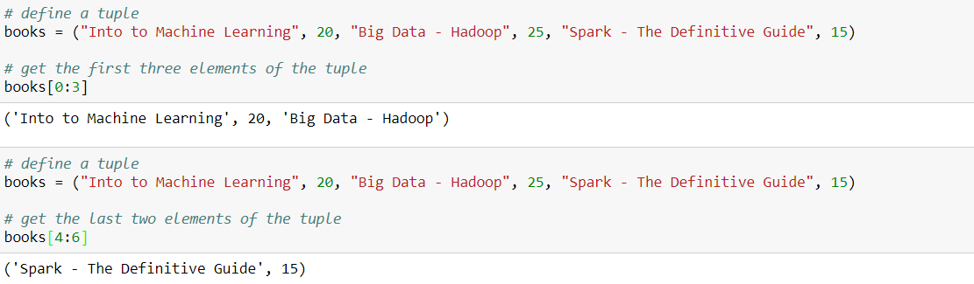
Indexing and Slicing tuples

Slide 18
Dictionary

Slide 19
Dictionary object
Elements exists in key-value pairs
Use {} curly brackets for creating a dictionary
[] square brackets for indexing it
Dictionaries are mutable and unordered

Slide 20
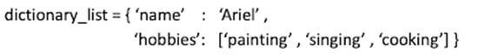
How does dictionary object look like?
Key 1
Value 1
Key 2
Value 2

Slide 21
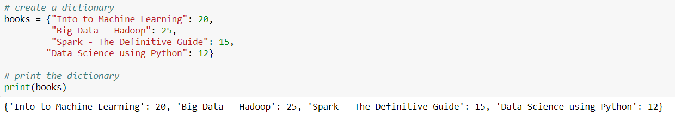
Creating dictionary object

Slide 22
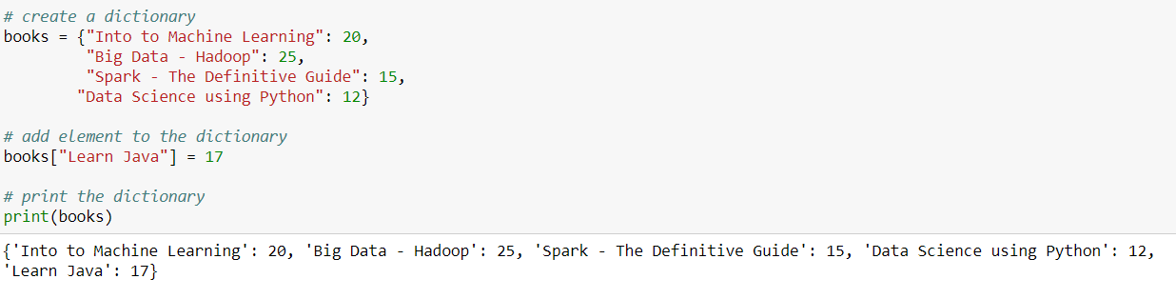
Dictionary operations
Adding an element in a dictionary

Slide 23
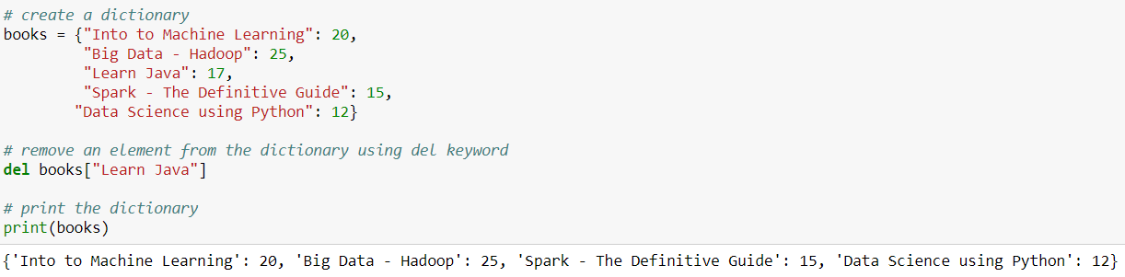
Dictionary operations
Removing an element from a dictionary

Slide 24
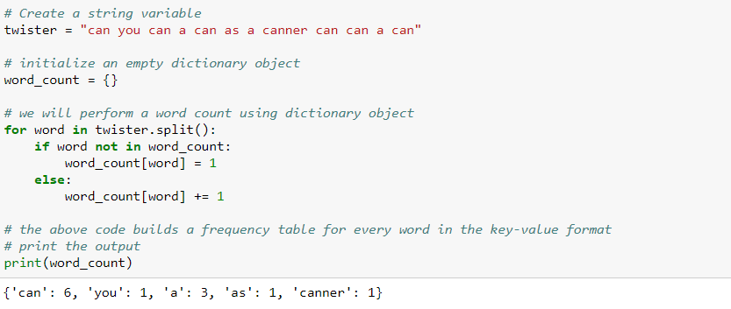
Dictionary - Word Count Example

Slide 25
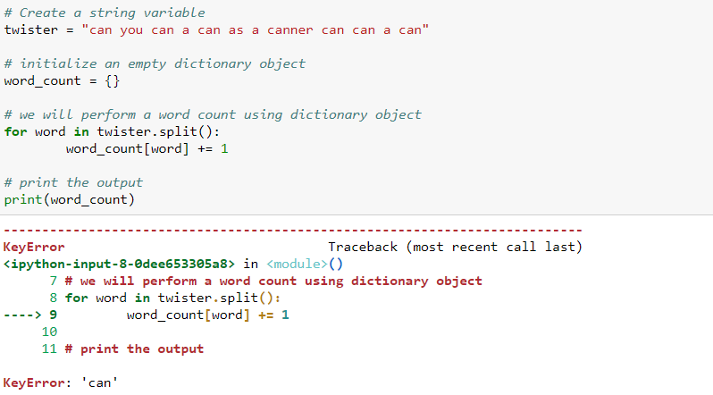
Consider the word count program below
The above code throws an error because the key is not initialized and we are trying to add 1 to an the uninitialized key’s value

Slide 26
Default dictionary
In order to avoid the error for uninitialized values, we use defaultdict()
Import the defaultdict from collections module
Initialize the dictionary object with defaultdict()
Note: We passed int() to the defaultdict()
When the dictionary object encounters a key that was not seen before, it initializes the key with a value returned by int(), in this case 0 (zero)

Slide 27
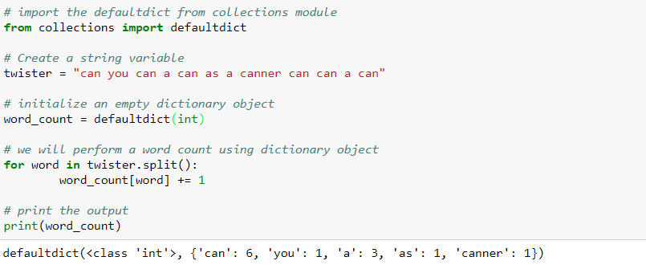
Dictionary object: Default dictionary
Import the defaultdict from collections module
Initialize the dictionary object with defaultdict()
Note: We passed int() to the defaultdict()
When a dictionary object encounters a key that was unseen before, it initializes the key with a value returned by int(), in this case 0

Slide 28
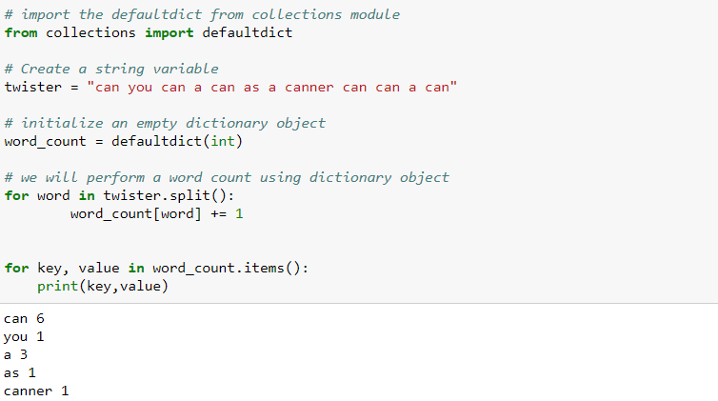
Looping through the dictionary
Use keys to loop through the keys in the dictionary object
Use values to loop through the values in the dictionary object

Slide 29
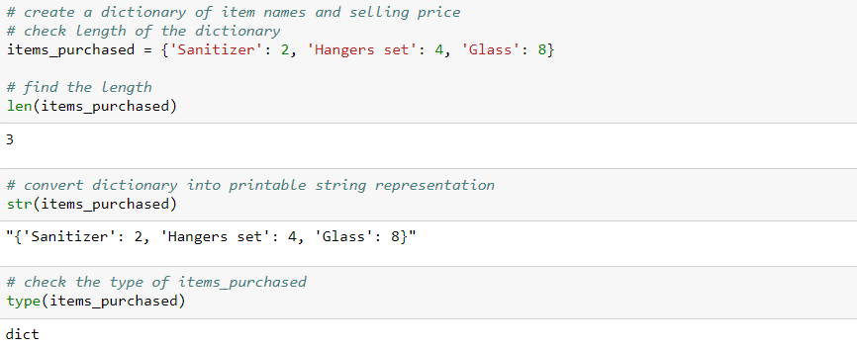
Dictionary operations

Slide 30
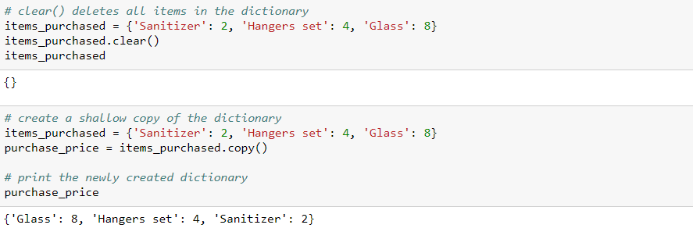
Dictionary operations

Slide 31
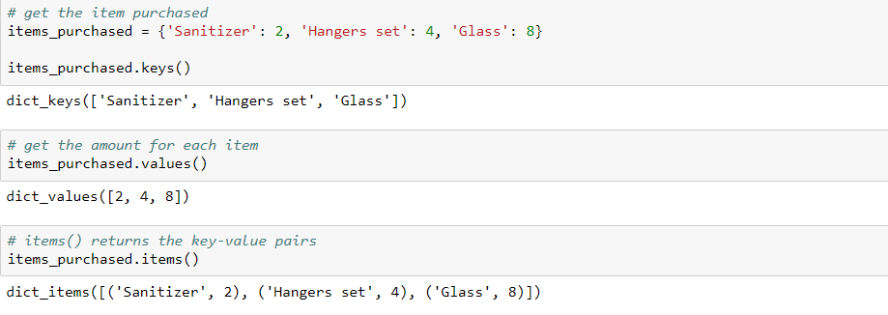
Dictionary operations

Slide 32
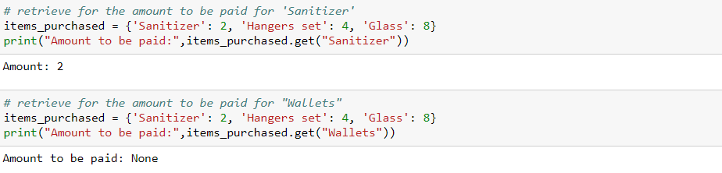
Dictionary operations
There is ‘Wallets’ purchased in the keys. Thus, get() returns ‘None’ as output

Slide 33
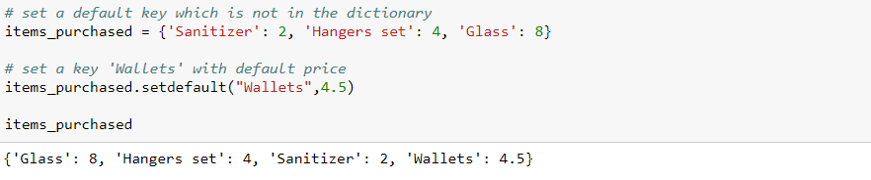
Dictionary operations

Slide 34
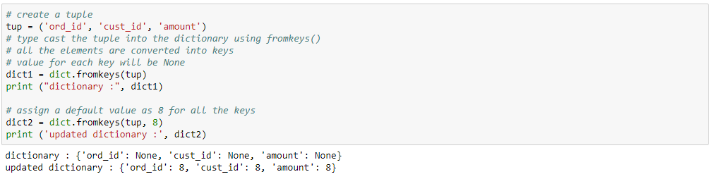
Dictionary operations

Slide 35
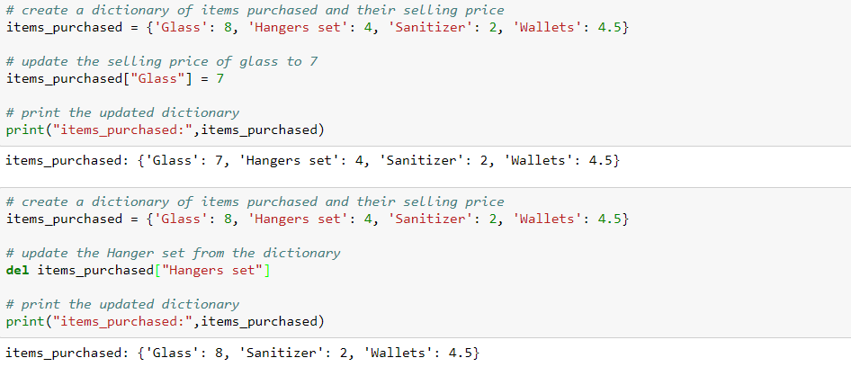
Dictionary operations

Slide 36
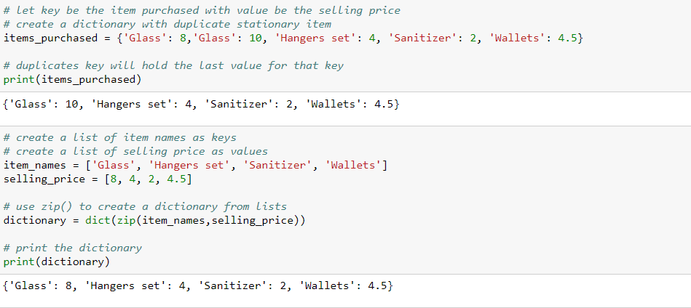
Dictionary operations
zip() pairs the corresponding elements of the list as a key and value of dictionary

Slide 37
THANK YOU
Presenter’s Name
Contact Us
support@knowledgehut.com
Presenter’s Designation

